Slide 1
Topic 2: Predictive QoS for V2X Connected Automated Mobility
Onur Sen, Louis Andrée, Yeji Shim

Slide 2
Agenda
Data Collection Component
Database
Data Prediction Component
Neural Network
Linear Regression
Edge Cloud
Conclusion / What we’ve learned

Slide 3
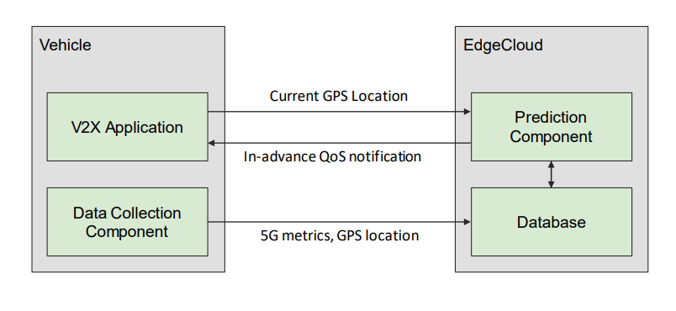
Architecture

Slide 4
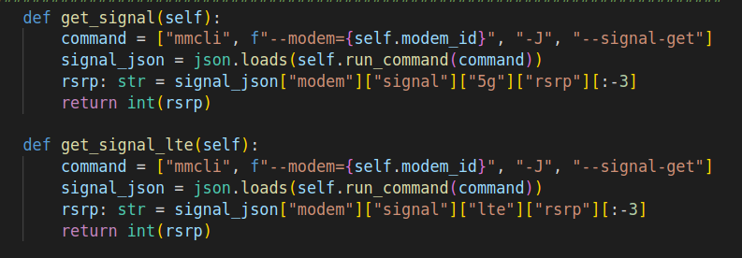
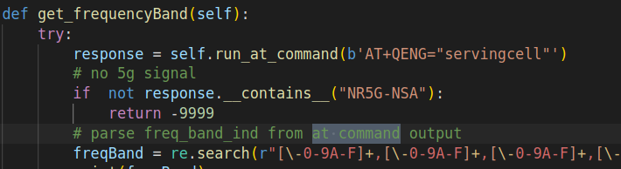
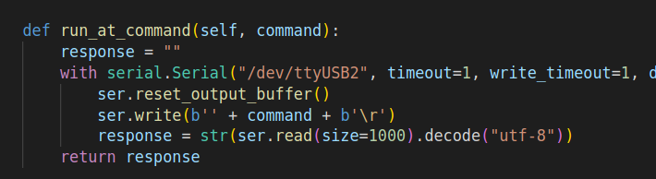
Data Collection Component
We used Quectel RM-500Q-GL EVB to connect with cellular Network
Script for collection uses mmcli and AT commands to communicate with EVB
v

Slide 5
Data Collection Component - How to Run
1. Put the SIM inside Slot 1 of the EVB
2. Connect the EVB to your Ubuntu PC with the USB cable
3. start the board by first switching the power switch(S103) on and then the boot switch(S101)
4. Now you have to establish the connection to the cellular network on your PC
5. Wait for GPS fix. This can take about 5 minutes. You can check by running: mmcli --modem=<yourModem> --location-enable-gps-nmea followed by: mmcli --modem=<yourModem> --location-get

Slide 6
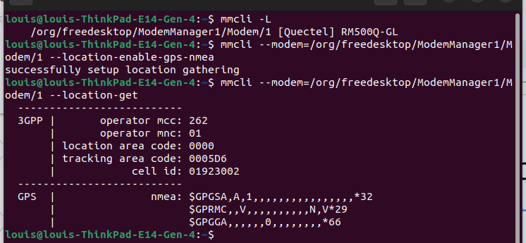
Data Collection Component
no GPS-fix

Slide 7
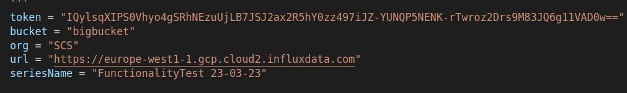
Data Collection Component
6. setup the database connection in the settings.py
7. decide whether you want to run the dummy modem or real modem in settings.py
8. start the script with sudo rights:
sudo python3 src/main.py

Slide 8
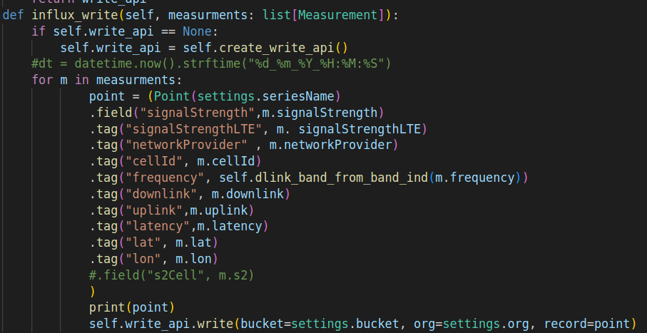
Sample Data
{"signalStrength": -96, "signalStrengthLTE": -93,
"networkProvider": "Telekom", "cellId": 90604329,
"frequency": 5, "lat": 52.51355, "lon": 13.35555,
"uplink": 40.67,
"downlink": 12.78,
"latency": 18.333}

Slide 9

InfluxDB

Slide 10
Prediction Component
We decided to make predictions in 2 ways.
Deep Learning with Neural Network
Machine Learning with Linear Regression

Slide 11
Neural Network
How Should we design the neural network?

Slide 12
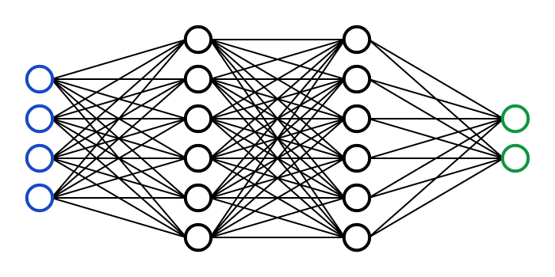
Neural Network architecture
Input layer Hidden layer Output layer

Slide 13
Sample Data
{"signalStrength": -96, "signalStrengthLTE": -93,
"networkProvider": "Telekom", "cellId": 90604329,
"frequency": 5, "lat": 52.51355, "lon": 13.35555,
"gpsNmea": "$GPGGA,112330.941,5230.813,N,01320.289,E,1,12,1.0,0.0,M,0.0,M,,*6D",
"qosMetrics": [18.333, 0.0, 39.67],
"uplink": 40.67,
"downlink": 12.78,
"latency": 18.333}

Slide 14
Input Layer
Most Relevant
Latitude 54.1234
Longitude 2.421
CellID 90604329
SignalStrength -97
SignalStrengthLTE -80

Slide 15
Input Layer
Latitude 54.1234
Longitude 2.421
CellID 90604329
Switch 0

Slide 16
Why not more inputs?
Frequency
hard to predict with our given data
Time
due to different time intervals, hard to implement
Signal Strength (LTE)
we made some NN predictions but the results were bad
feeding our results into NN led to worse results

Slide 17
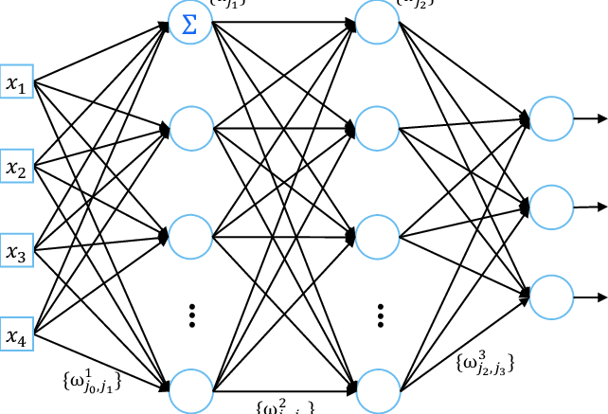
Neural Network
We decided to go with the simpler approach and use only one neural network for all our predictions
Lat Uplink
Lon Downlink
CellId Latency
Switch

Slide 18
Output Layer
First Ideas: Make one unique Neural Network for each predicted Output
NN ->Latency
NN->Uplink
NN-> Downlink

Slide 19
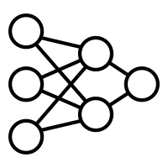
Endless neural network possibilities
NN ->Latency -> NN + Latency -> uplink, Downlink -> NN + Latency + Downlink ->uplink
NN->Uplink -> NN+ Uplink -> uplink, Downlink -> NN + uplink + Downlink -> Downlink
NN-> Downlink -> NN+ Downlink -> Latency, Uplink -> NN + Downlink + Uplink -> Latency

Slide 20
New Issue
The Vehicle only sends us the latitude and longitude, but how can we predict the cell and the handover from one cell to another?

Slide 21
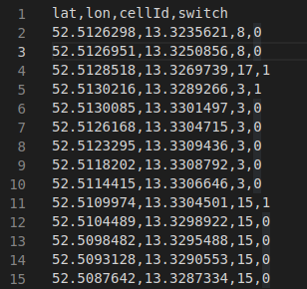
Switch?
*Check if the last cell ID is different to the current one
If yes, set switch to 1, else 0
1 / 0 approach is important for Normalization

Slide 22
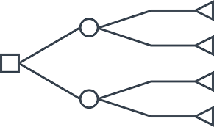
Cell Prediction
In order to predict the cell that a vehicle is using and the handover, we decided to go with decision tree machine learning
Input: Latitude, Longitude ROUTE
Output: Cell ID, Switch -> determined by regression

Slide 23
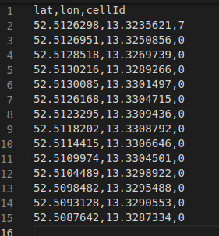
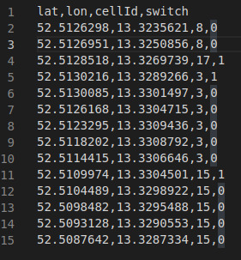
Cell prediction and switch in Action

Slide 24
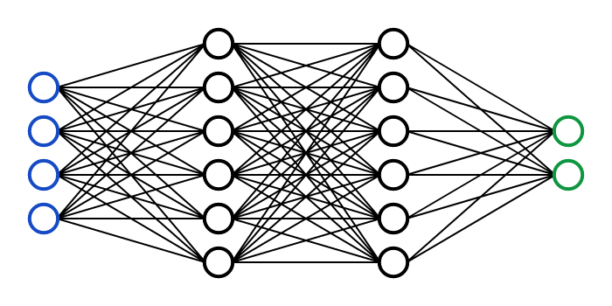
Neural Network architecture
Learning rate
Batch size
Layers
Activation function
Normalization
Dropout

Slide 25
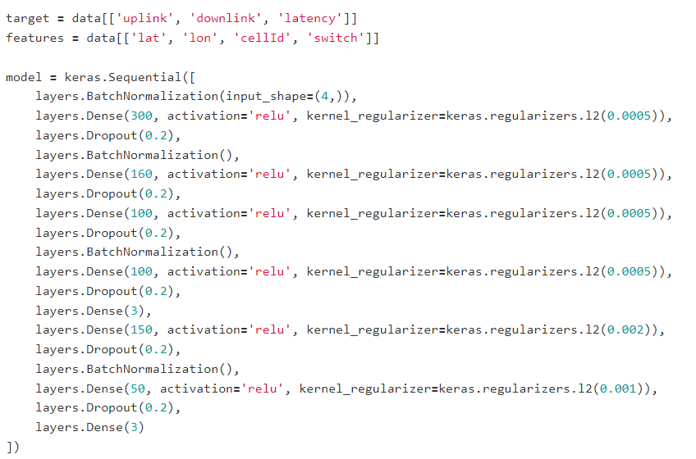
Hidden Layer (NN) / Code Example

Slide 26
Problems
Since there are different network providers with different bases stations, we might receive the wrong cells if we don’t consider all providers in the area.
For now we will only focus on vodafone.
There are different cells for each base station, which makes mapping all the cells hard at first. Cells which were mapped for a given latitude, longitude might change overtime due to workload.

Slide 27
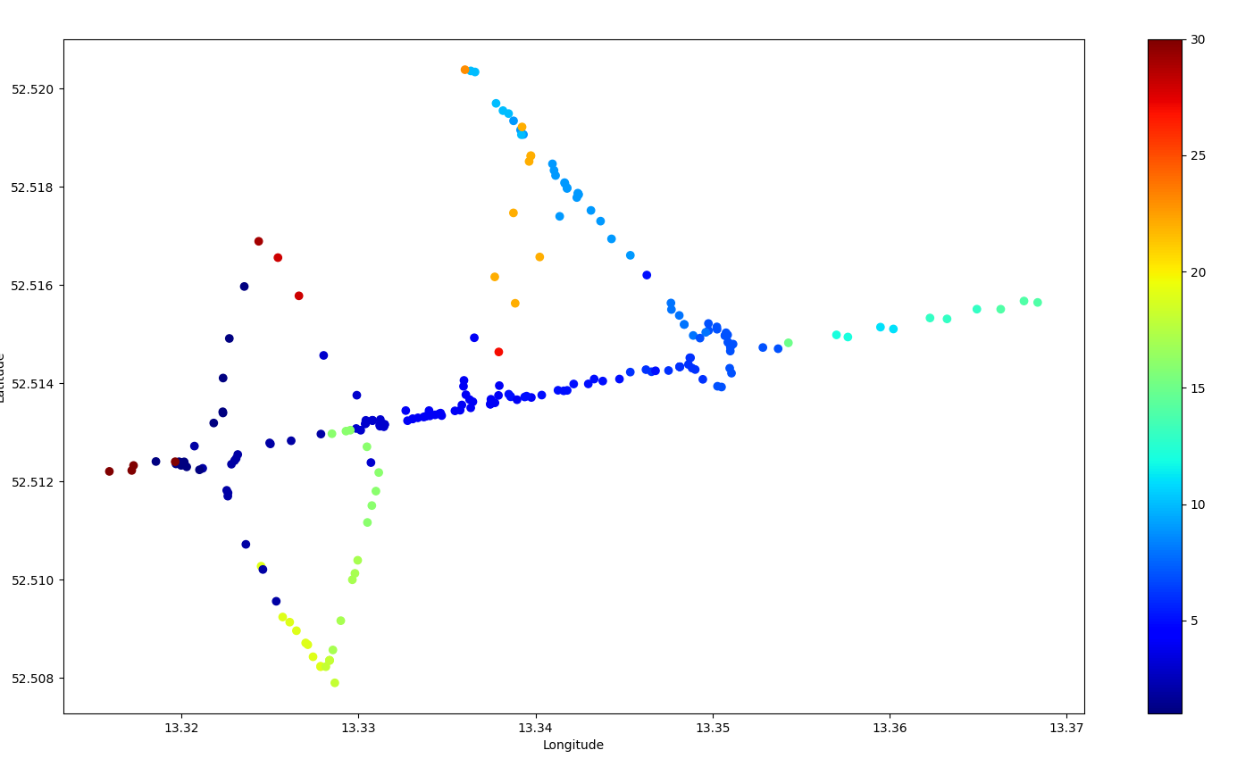
Example

Slide 28
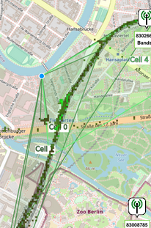
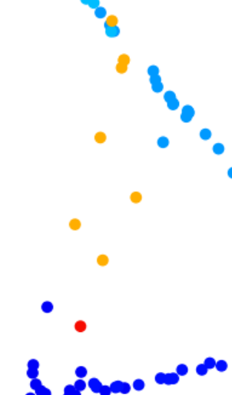
Example

Slide 29
Workaround
Instead of mapping each cell as a unique id, we could just map their base stations and generalize everything or use QoS metrics to identify each cell.
Fixes the Issue of different cells
But we could take the switch from the cells over time as additional information for overload and make better predictions for the future.

Slide 30
Prediction Component - First Issue : ARIMA Model
First, we had chosen a ARIMA Model to make predictions on Latency, Uplink and Downlink in time series.
the ARIMA is…
based on time-series
considers univariate variable

Slide 31
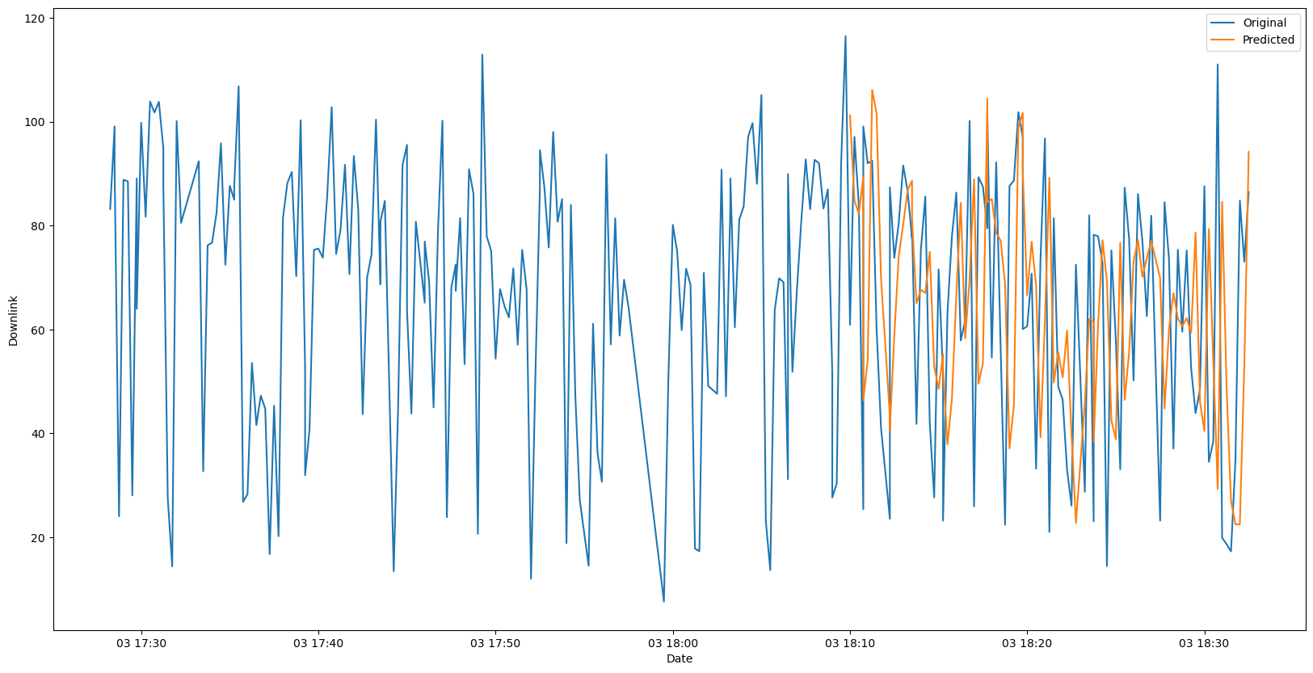
z.B Downlink Prediction on the test set : ARIMA
The ARIMA model is well-fitted and also quite well-predicted.
However, the problem is : this model predicts only based on time-series, without regarding four important feature-values ( Longitude, Latitude, CellId, CellSwitch ).
☞ Solution: VAR (Vector Autoregression) model

Slide 32
Prediction Component - Second Issue : VAR Model
As a solution, we chose to make predictions with the VAR (Vector Autoregression) model and took the values (longitude, latitude, cellId, and switch) into account.
the VAR model is…
time series model that allows to model multiple variables that are interdependent and affect each other over time.
Considers Multivariate variables

Slide 33
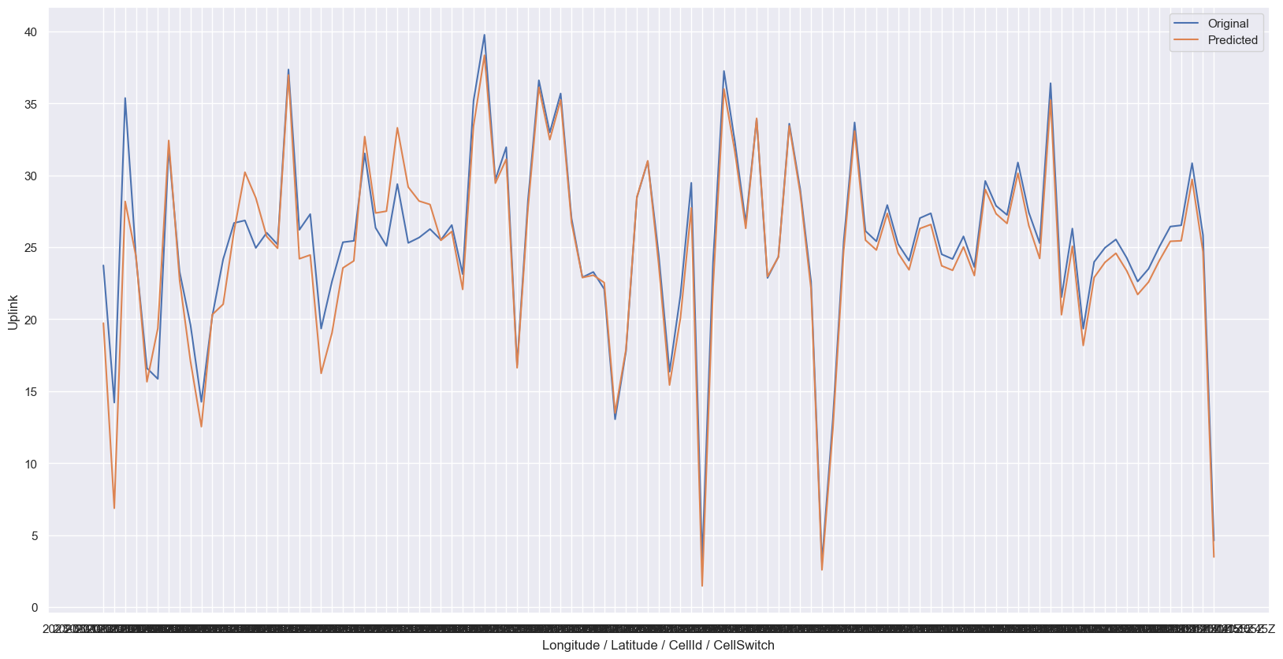
Uplink Prediction on the test set : VAR
The prediction result seems to be very precise and almost perfectly trained.

Slide 34
Problem : New prediction on the future target variables
We aim to realize new predictions on the future of target variables (Uplink, Downlink,Latency) using the trained model with new data only including feature variables. => we should define feature- and target-variables respectively.
However, the problem is :
In a VAR model, all variables are considered as both predictors and targets. Therefore, there is no clear distinction between them.
So, we could not use the trained model for new prediction…
☞ Solution : Linear Regression
Notes:
When we fit a VAR model, we should specify all the variables we want to include in the model, which means, for example, if we want to predict latency based on the inputs of longitude, latitude, cellId and switch, we should then include all five variables in VAR model.
So we cannot use the trained model when we want to predict with only 4 feature variables.

Slide 35
Prediction Component - Final : Linear Regression
Linear regression is…
the most commonly used method of predictive analysis.
uses linear relationships between a dependent variable (target) and one or more independent variables (predictors) to predict the future of the target.
☞ Therefore, we are able to use the trained model to predict the target variables based on the feature variables.

Slide 36
Steps how to predict
Step 1: import our dataset and defined feature- and target variables.
Step 2: Fit a linear regression model.
Step 3: Verify that the model fits the data well.
Step 4: Predict target on the test set.
Step 5: Use the fitted model to predict the future of target based on new data.

Slide 37
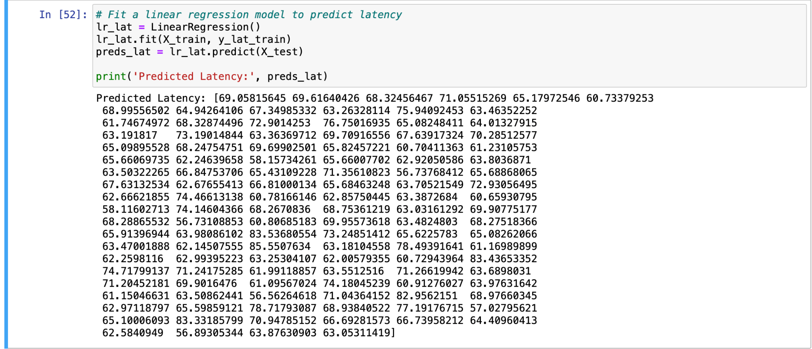
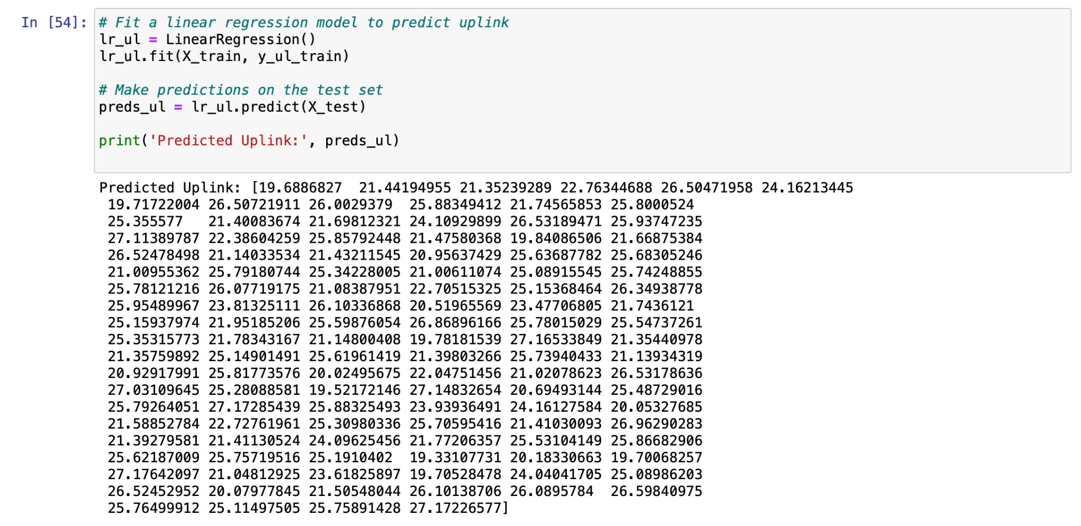
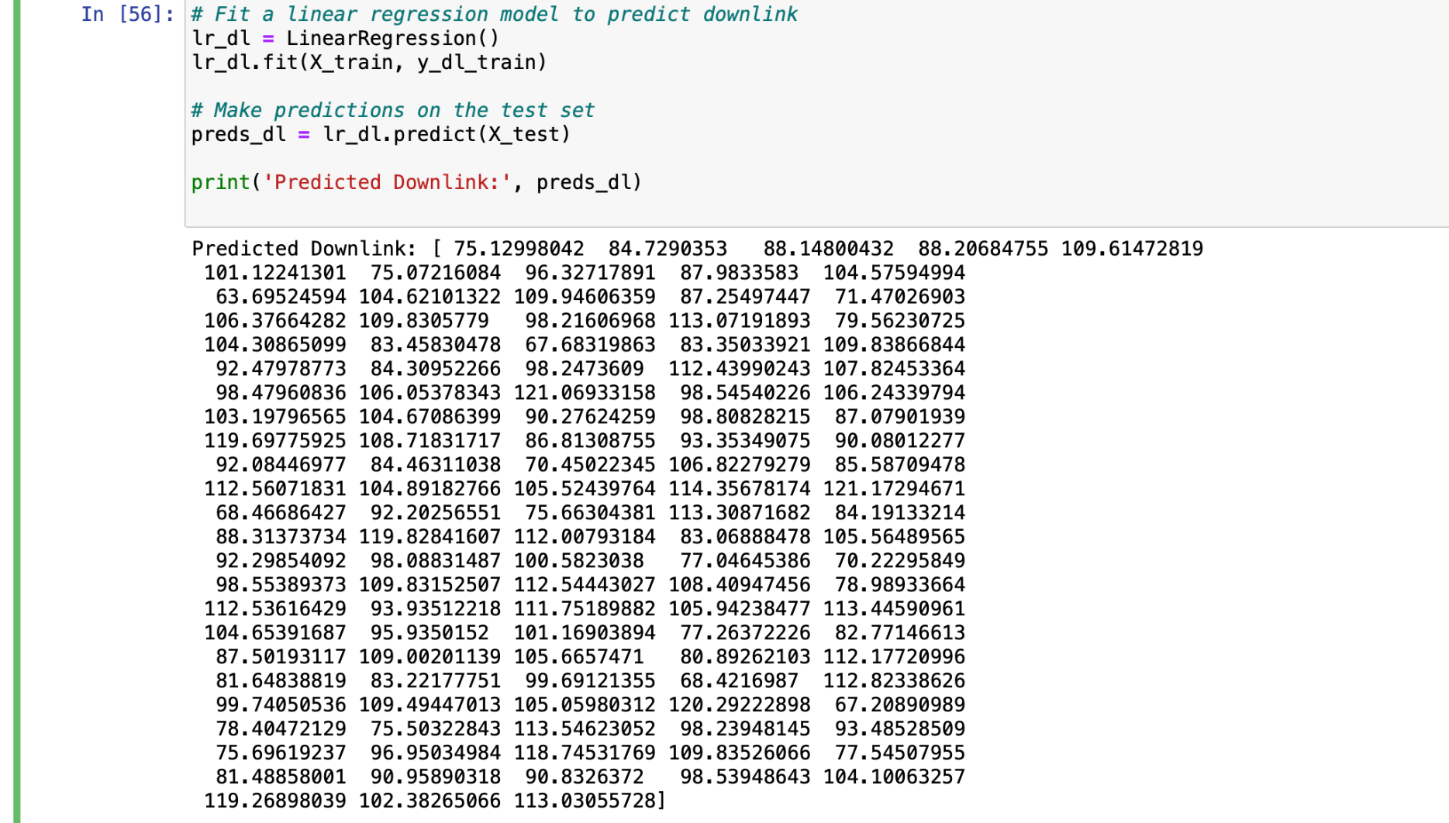
Prediction result

Slide 38
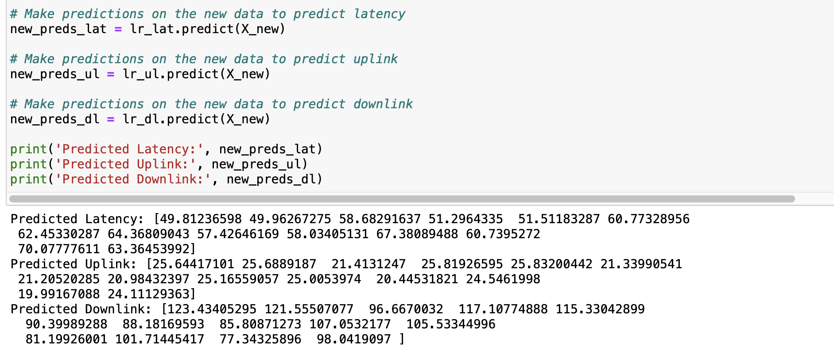
New prediction(Forecasting) result

Slide 39
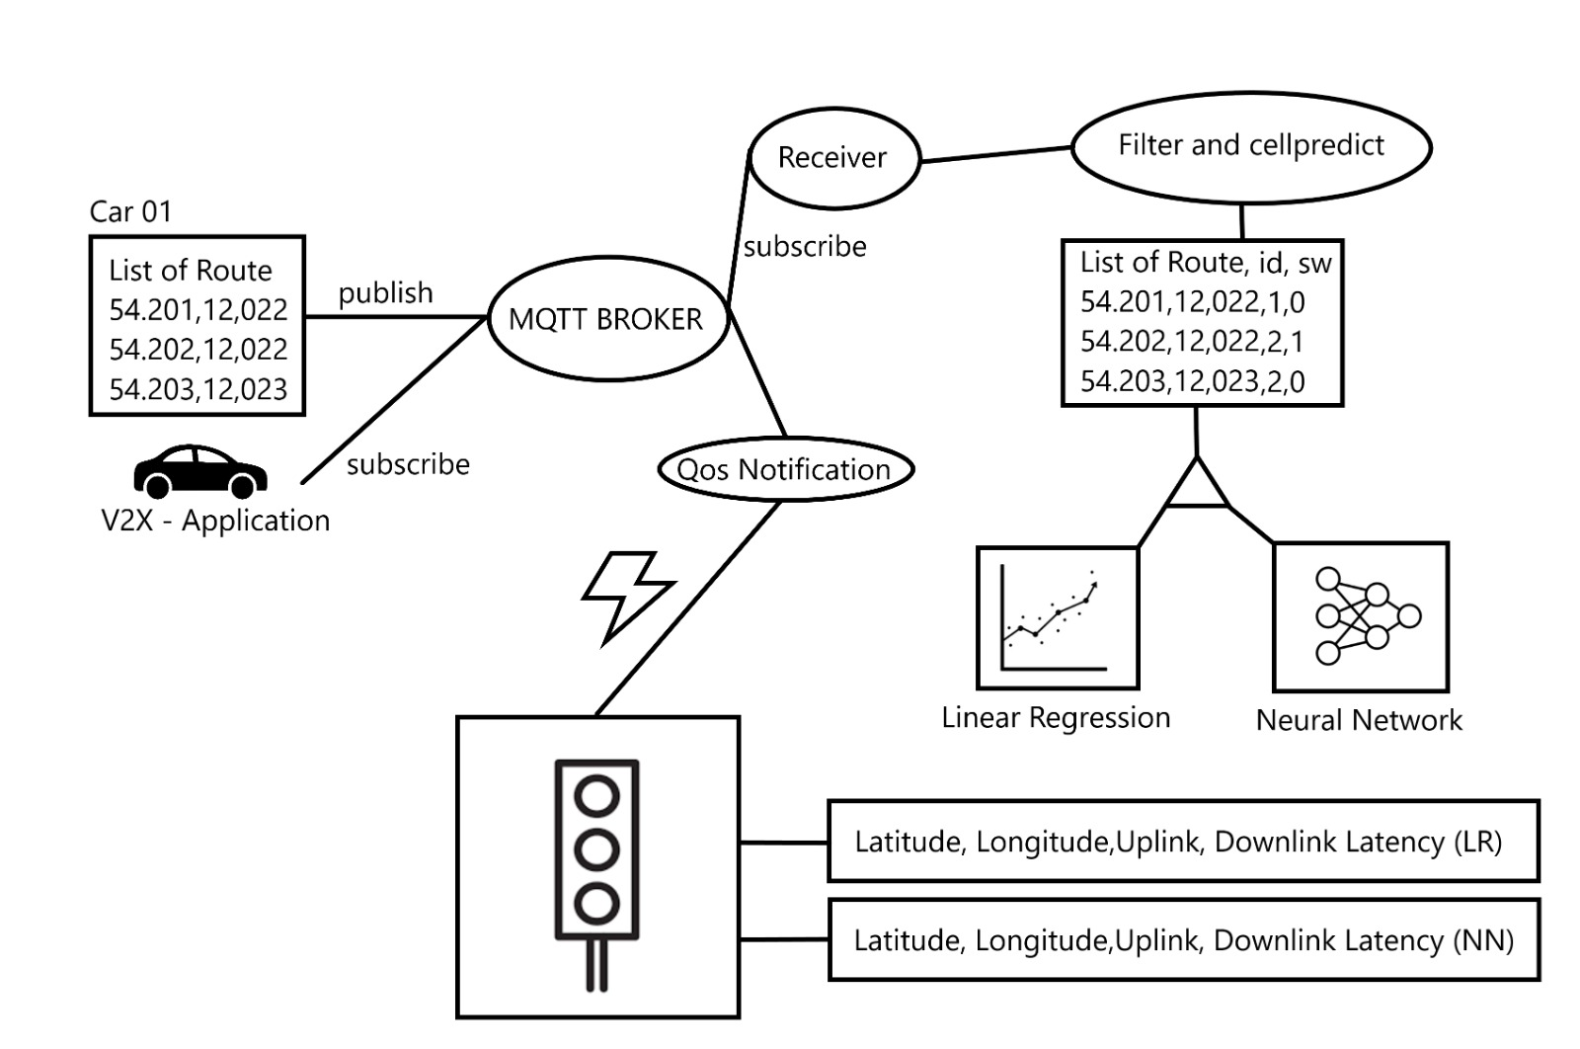
Edge Cloud - V2X

Slide 40
Edge Cloud - How to generate and train the models
To generate the Decision Tree for Cell prediction start the Decisiontree.py. You will be asked to load a .csv file for training.
For the Keras Model run the TensorFlow.py. Again you will be asked to give it a csv file for training
For the Linear Regression Model run the LinearRegression.py and select the training data
All of these scripts export their generated models and can be accessed later

Slide 41
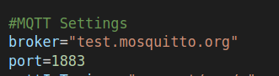
Edge Cloud - How to run the prediction component
1. Setup your MQTT Broker
2. Add the credentials of your MQTT Broker in settings.py
3. start the prediction component by running python3 server.py
4. You will be asked to
select decision Tree
select Keras Model
select LR models
4. Now you can start the v2x-app when everything is setup correct the server will receive the route from v2x and return the LR and NN predictions
5. Check the result in v2x-app and the result folder

Slide 42
V2X Application
This simulates a car that is transmitting its predefined route to the Edge Cloud and awaits a response from the Keras & Linear Regression Model
Communication happens over the MQTT.
publishing under topic: request/car/<carID>
subscribing to: response/car/<carID>/NN & response/car/<carID>/LR
When both responses have been received the are merged and are ready for evaluation

Slide 43
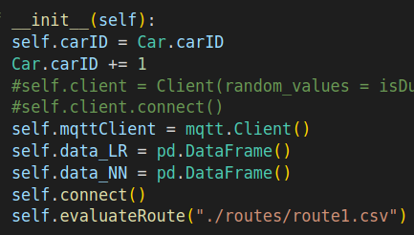
V2X Application - How to run
setup your mqtt Broker
Add the credentials of Mqtt to the settings.py
Edit which route you want to predict
start the script by running python3 src/car.py
If everything is working you will receive 2 csv files that will be combined and saved in the result folder
Note: the prediction component has to be running before starting the v2x-app. The request are not saved.

Slide 44
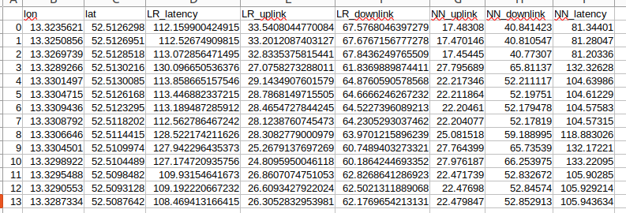
V2X - Application Result

Slide 45
Conclusion
More Data, better Predictions (over different time span)
Combine different network providers to receive patterns for overall QoS
More inputs (NN), better prediction
We’ve learned from this project…
how to create the architecture, plan and advance the procedures by ourselves
how to communicate with team members
how the network architecture look like
how to connect with network and to collect real datas by using Board
machine learning skills through lots of attempts
more familiar to python language
how to manage Gitlab
and even get more detailed about what we want to study/further on career!

Slide 46
References
Prasad, A. (2021). The Complete Guide to Time Series Analysis and Forecasting. Towards Data Science. Retrieved from
“https://towardsdatascience.com/the-complete-guide-to-time-series-analysis-and-forecasting-70d476bfe775”
Yadav, S. (2021). Designing Your Neural Networks. Towards Data Science. Retrieved from
“https://towardsdatascience.com/designing-your-neural-networks-a5e4617027ed”
Google LLC. (n.d.). S2 Geometry: S2Cell Hierarchy. Retrieved from
“https://s2geometry.io/devguide/s2cell_hierarchy.html”
Speedtest-CLI https://www.npmjs.com/package/speed-cloudflare-cli
InfluxDB Database https://europe-west1-1.gcp.cloud2.influxdata.com

Slide 47
Thank you for listening!

